Slide 1
Interim Demo
By: Ryan Schofield

Slide 2
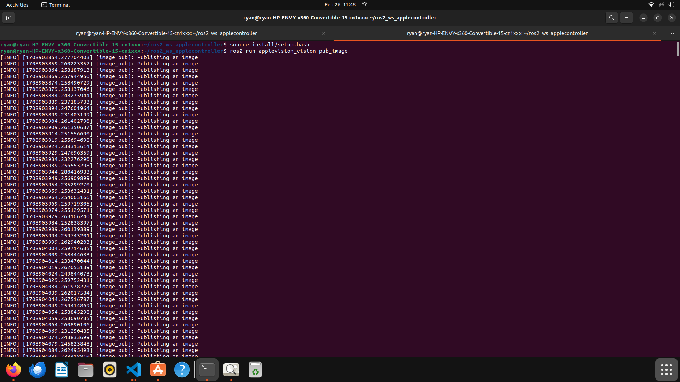
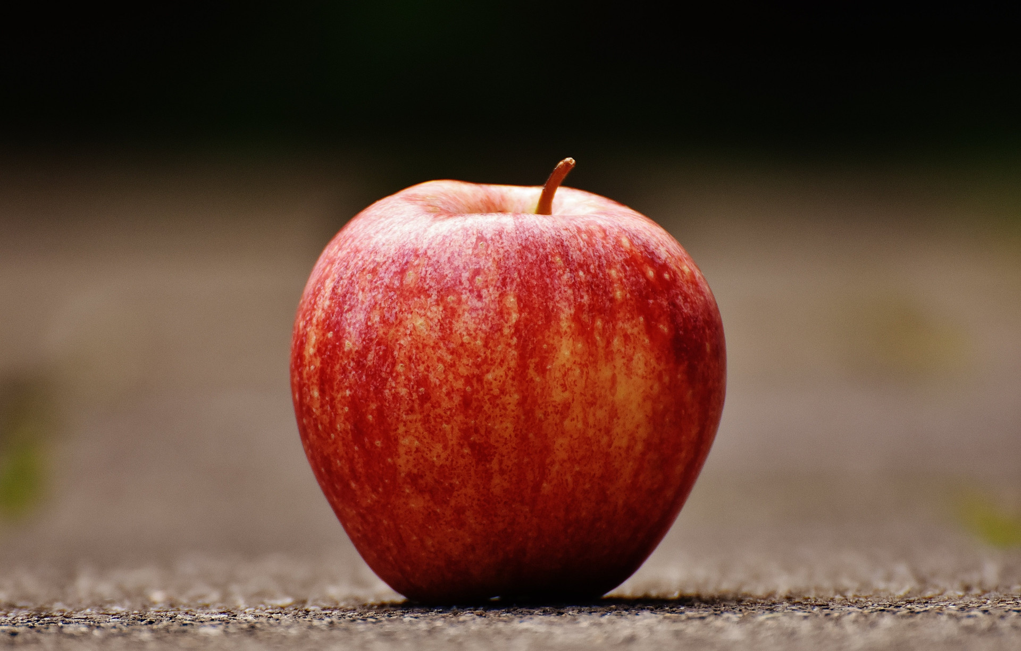
Publishing an image every 5 seconds
Just this image for right now

Slide 3
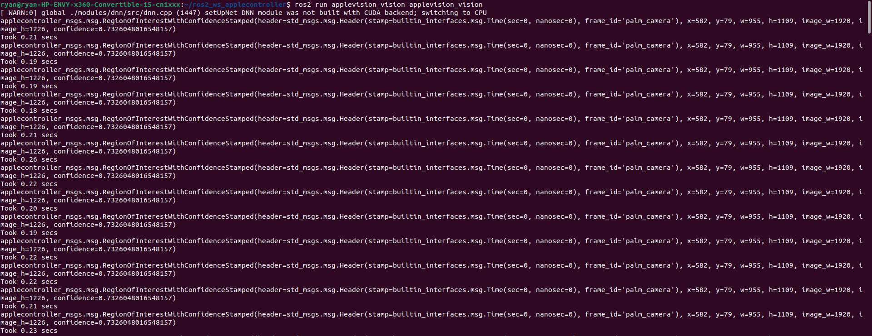
Sending a Custom Message of the Area of Interest
Takes in image and publishes where it thinks the apples is and how confident it is. It also prints how long it took to get this information

Slide 4
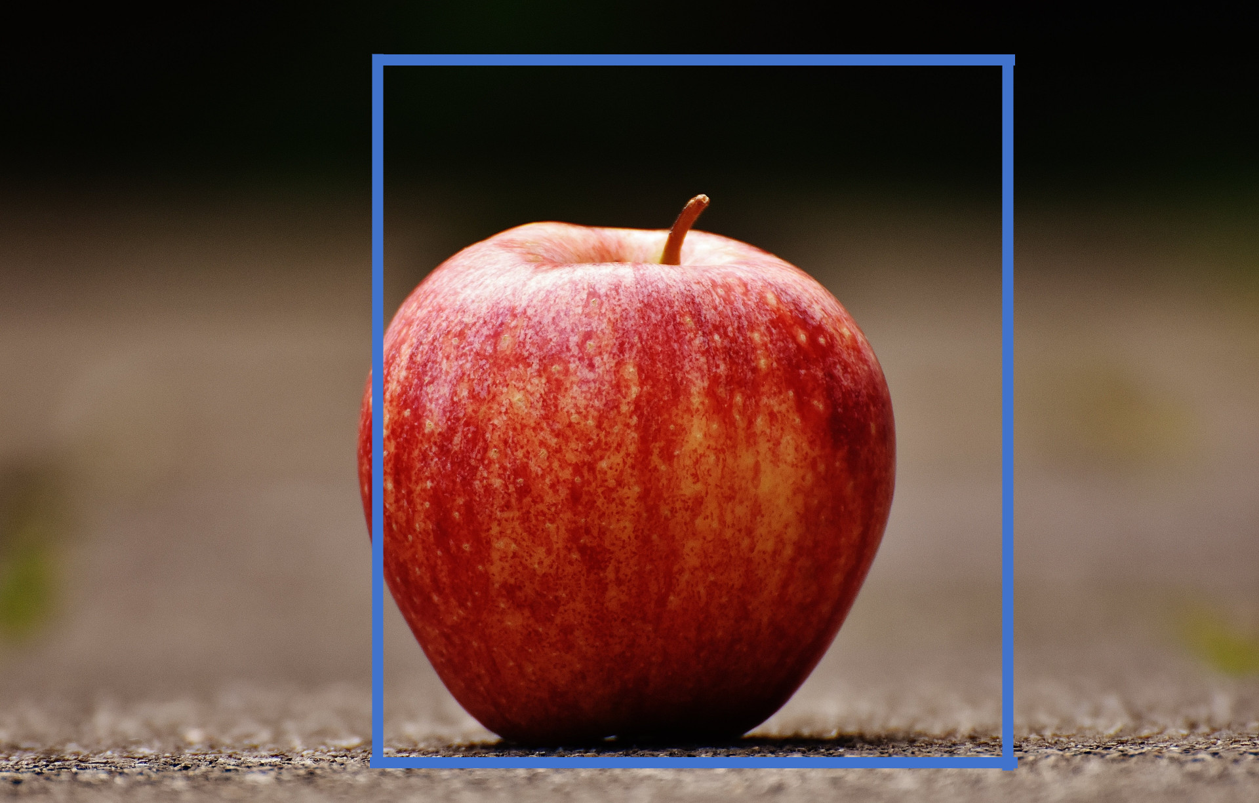
Where it thinks the area of interest is
Thinks the apple is in the box. It is accurate enough for what I am doing. This box is drawn manually because I haven’t figure out how to get it to draw it automatically yet.

Slide 5
GitHub
My Github: https://github.com/ryanschofield9/Rob599/tree/main
Look in the following folders for project code
applevision_vision
applecontroller_msgs
helpers
Original Ros1 Github: https://github.com/OSUrobotics/applevision_rospkg/tree/master

